Slide 1

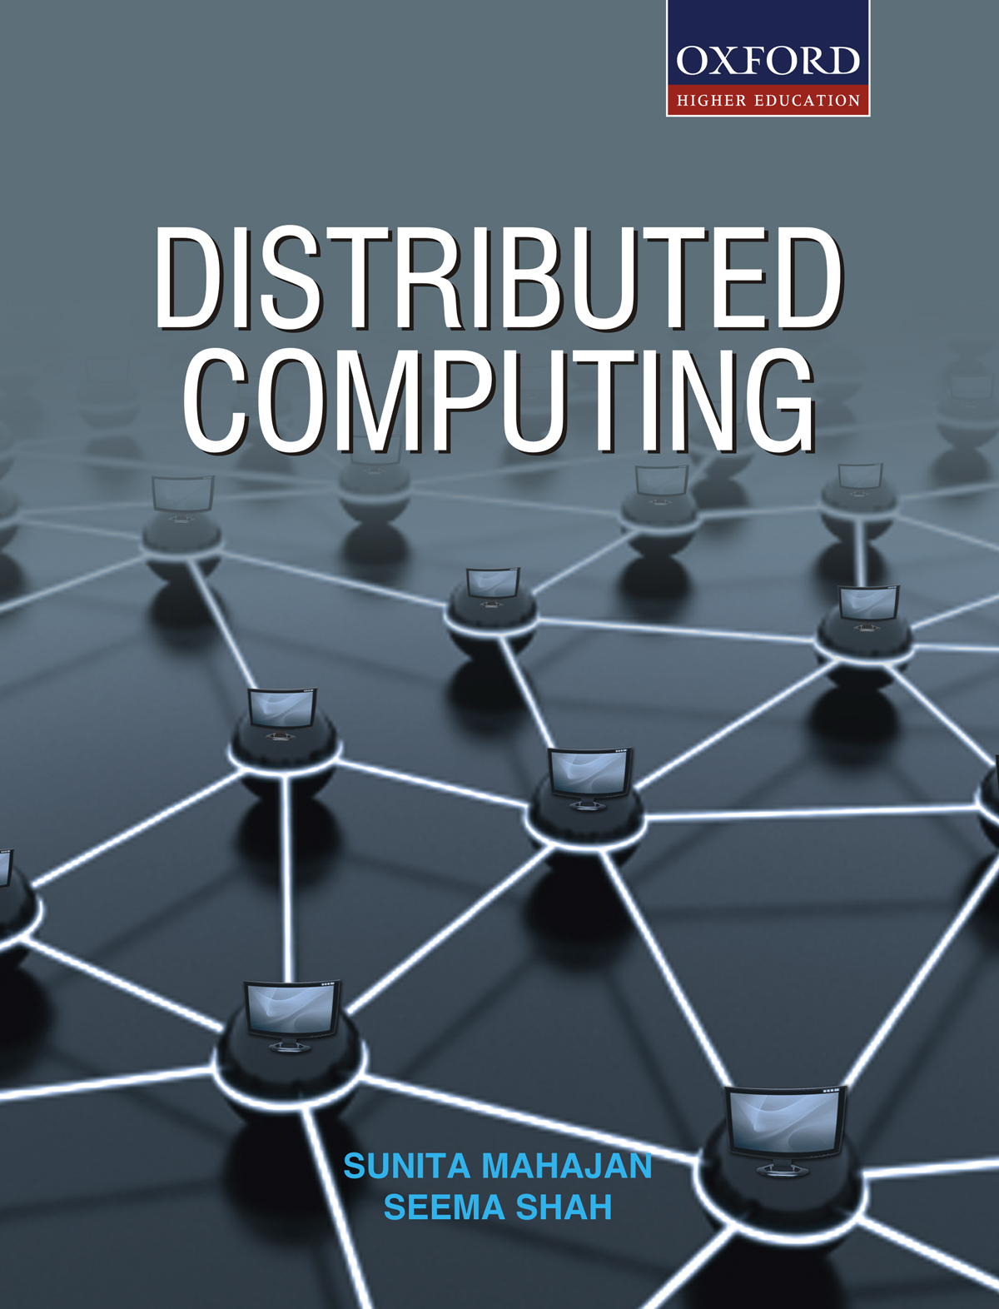
DISTRIBUTED COMPUTING
Sunita Mahajan, Principal, Institute of Computer Science, MET League of Colleges, Mumbai
Seema Shah, Principal, Vidyalankar Institute of Technology, Mumbai University

Slide 2
Chapter - 10
Security In Distributed Systems

Slide 3
Topics
Introduction
Overview of security techniques
Secure channels
Access control
Security management
Case study

Slide 4
Introduction

Slide 5
Goals of computer security
Secrecy
Privacy
Authenticity
Integrity

Slide 6
Approaches to computer security
Physically limited access
Hardware mechanisms
Operating system mechanisms
Programming strategies

Slide 7
Complete security
External security
Internal security
  User authentication
  Access control
  Communication security

Slide 8
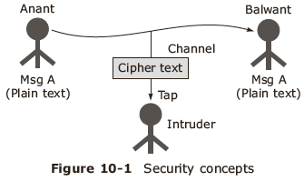
Potential threats and attacks
Interception
Interruption
Modification
Fabrication

Slide 9
Security mechanisms
Encryption
Authentication
Authorization
Auditing tools
Intruder : person/program vying for unauthorized access to data

Slide 10
Attacks
Passive attacks
Browsing
Inferencing
Masquerading
Active attacks
Virus
Worm
Logic bomb
Integrity attack
Authenticity attack
Delay attack
Replay attack
Denial attack

Slide 11
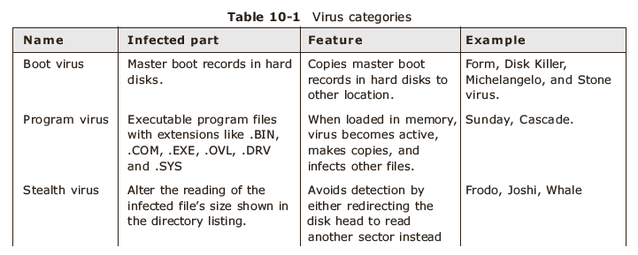
Categories of Virus-1
(Continued in next slide)

Slide 12
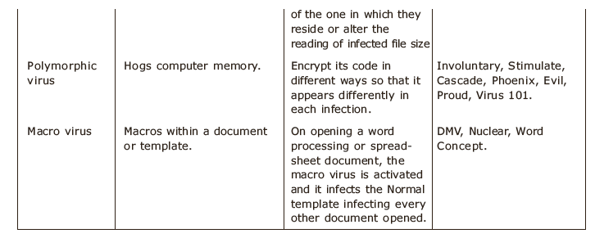
Categories of Virus-2

Slide 13
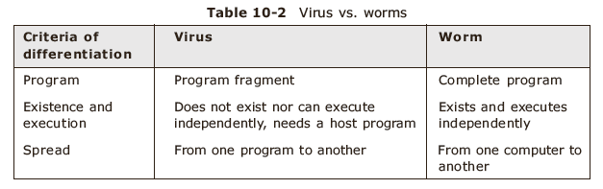
Virus vs worm

Slide 14
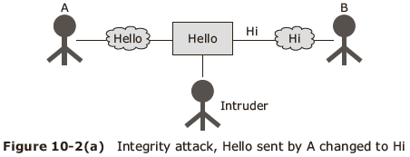
Integrity Attack

Slide 15
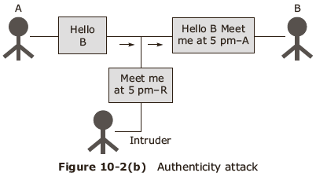
Authenticity attack
A

Slide 16
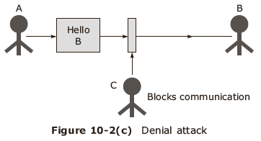
Denial attack

Slide 17
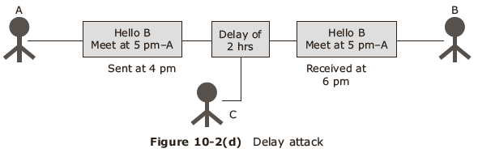
Delay attack

Slide 18
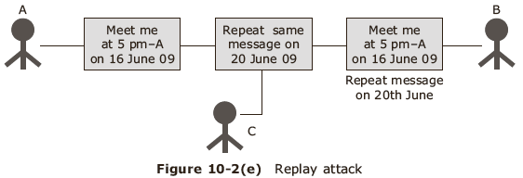
Replay attack

Slide 19
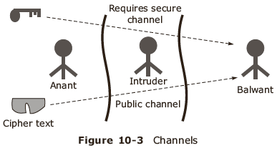
Confinement problems

Slide 20
Types of channels
Legitimate channel
Storage channel
Covert channel

Slide 21
Design issues
Minimum privilege
Fail safe defaults
Build it into the system
Check for current authority
Easy grant and revocation of access rights
Build firewalls
Cost effectiveness
Simplicity

Slide 22
Focus of control
Protection against invalid operations on secure data
Protection against unauthorized invocations
Protection against unauthorized users

Slide 23
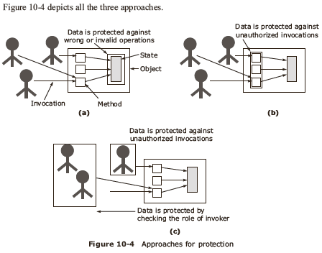
Protection

Slide 24
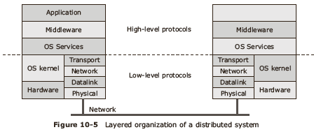
Layering of security systems
Application

Slide 25
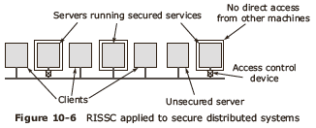
RISSC

Slide 26
Cryptography

Slide 27
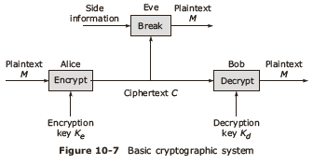
Basic operations:
Encryption and decryption

Slide 28
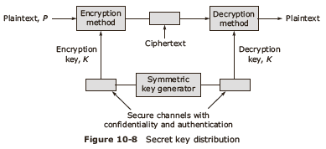
Types
Symmetric cryptosystem
Asymmetric cryptosystem
Using Hash function

Slide 29
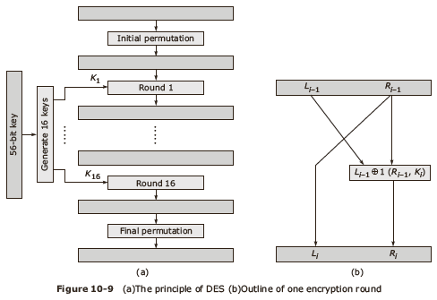
DES algorithm

Slide 30
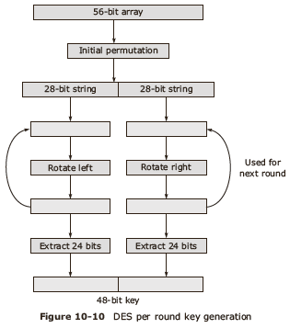
DES Key generation

Slide 31
Needham –Schroeder algorithm
Needham –Schroeder Symmetric key protocol
Needham –Schroeder public key protocol

Slide 32
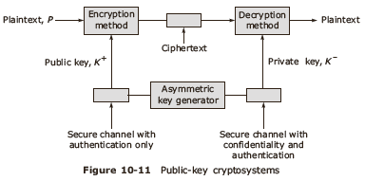
Asymmetric cryptosystem

Slide 33
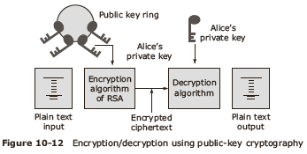
RSA protocol
Key generation
Encryption of message
Decryption of message
Digital signing
Signature verification
Alice’s
public key

Slide 34
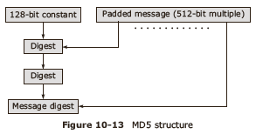
Hash function MD5

Slide 35
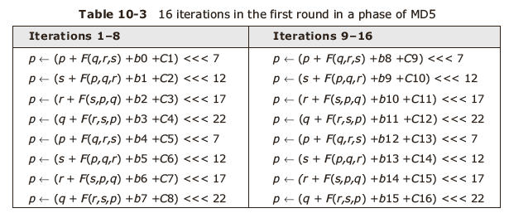
MD5

Slide 36
Secure Channels

Slide 37
Authentication
User login authentication
One way authentication of communicating entities
Two way authentication of communicating entities

Slide 38
User log in authentication
Maintain secrecy of passwords
Make passwords difficult to guess
Limit damage due to a compromised password
Identify and discourage unauthorized login
Adopt Single sign-on policy for using system resources

Slide 39
One way authentication of communicating entities
Protocols based on symmetric cryptosystems
Protocols based on asymmetric cryptosystems

Slide 40
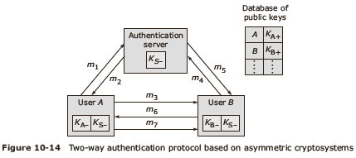
Two way authentication of communicating entities
K_{S+}

Slide 41
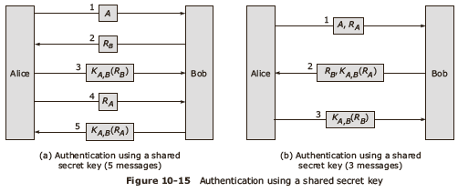
Authentication

Slide 42
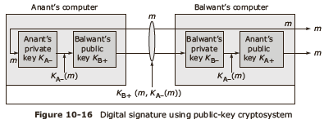
Message Integrity and Confidentiality
Digital signature

Slide 43
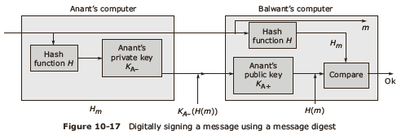
Using message digest
Session key

Slide 44
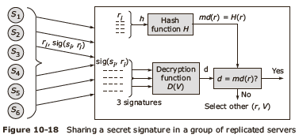
Secure group communication
Confidential group communication
Secure replicated servers

Slide 45
Access Control

Slide 46

General issues

Slide 47
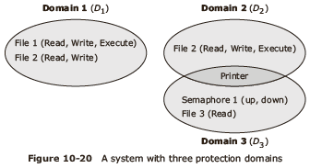
Protection domains
Domain is an abstract definition of a set of access rights

Slide 48
Realizing domains
Each user has a domain
Each process has a domain
Each procedure has a domain
Domains may be disjoint

Slide 49
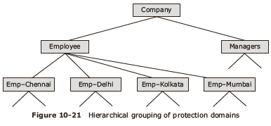
Hierarchical grouping

Slide 50
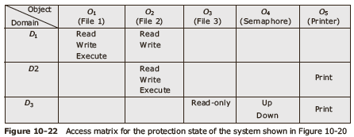
Access matrix

Slide 51
Issues in representing protection state
Deciding the contents of the access matrix
Validating access to objects by subjects
Allowing subjects to switch domains in a controlled manner
Allowing changes in the protection state of the system in a controlled manner

Slide 52
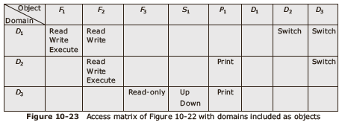
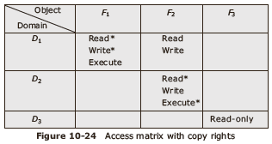
Access matrix- 1

Slide 53
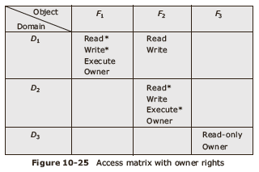
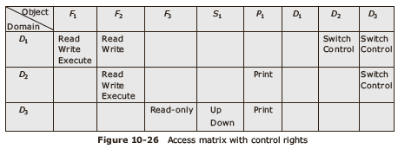
Access matrix-2

Slide 54
Implementation of Access Matrix
Access Control Lists (ACL)
  Access validation,
  Granting rights
  Passing rights
  Revoking rights
Capabilities

Slide 55
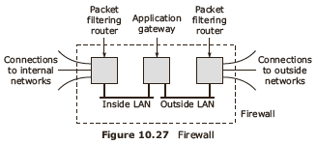
Firewalls

Slide 56
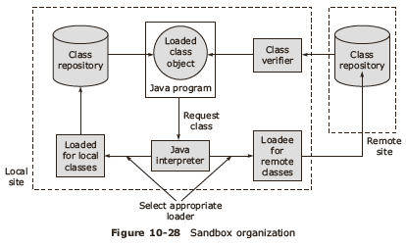
Secure mobile code
Protecting an agent
Protecting the target

Slide 57
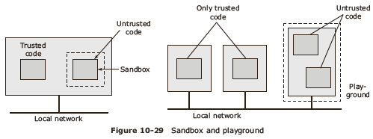
Sandbox

Slide 58
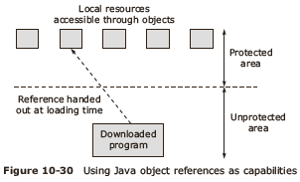
Java object references as capabilities

Slide 59
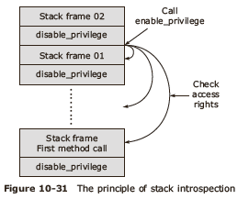
Stack introspection

Slide 60
Security Management

Slide 61
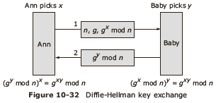
Key management
Key establishment
Diffe-Hellman key exchange

Slide 62
Key distribution
Key distribution in symmetric cryptosystem
  Centralized approach
  Fully distributed approach
  Partially distributed approach
Key distribution in asymmetric cryptosystem
Lifetime certificates

Slide 63
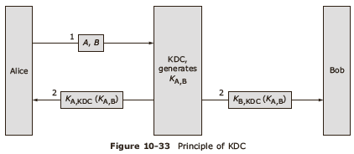
Issues in key distribution
Baby

Slide 64
Secure group management
  Have a group of secure servers
  Use KDCs and CAs
Authorization management
  Grant access rights to a user group
  Use capabilities to get access rights
  Capability is a list of ordered pairs, associated with a domain and defines all objects to which a domain has access rights

Slide 65
Capabilities
Access validation
Granting and passing rights
Protecting capabilities against unauthorized access
Rights amplification
Rights revocation
Hybrid approach

Slide 66
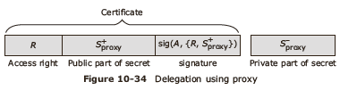
Delegation of access rights-1

Slide 67
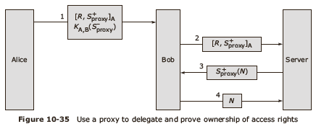
Delegation of access rights-2

Slide 68
Case Study

Slide 69
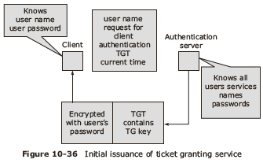
Kerberos system-1

Slide 70
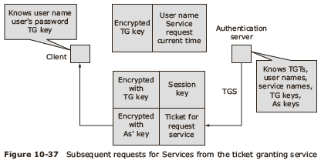
Kerberos system-2

Slide 71
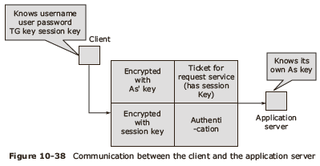
Kerberos-3

Slide 72
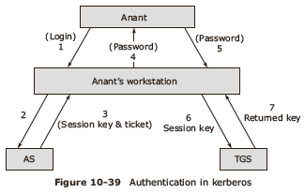
Kerberos-4

Slide 73
Epayment
Methods
Secure electronic transactions
  Open standard for protecting the privacy and ensuring the authenticity of electronic transactions
Major technologies used are
  DES for confidentiality of information
  RSA for data integrity
  Digital signatures with SHA-1 hash code

Slide 74
Summary
Introduction
Overview of security techniques
Secure channels
Access control
Security management
Case study

